Slide 1
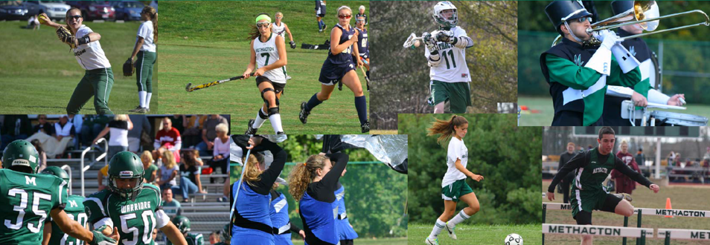

Slide 2
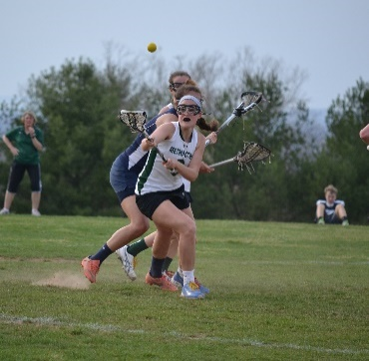
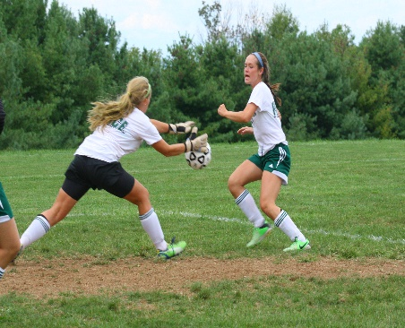
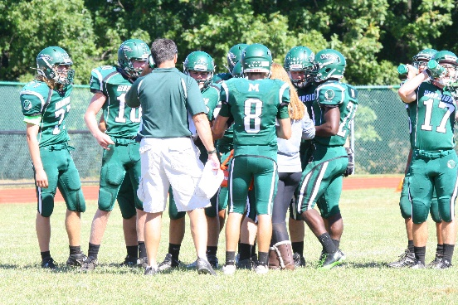
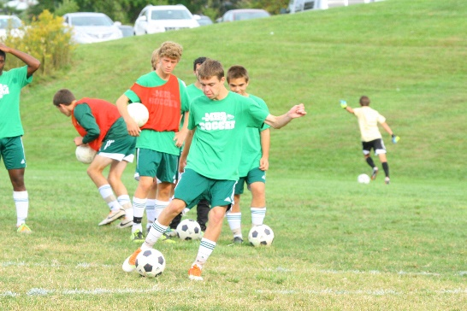
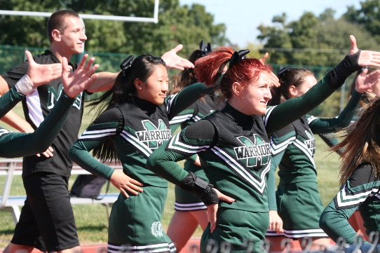
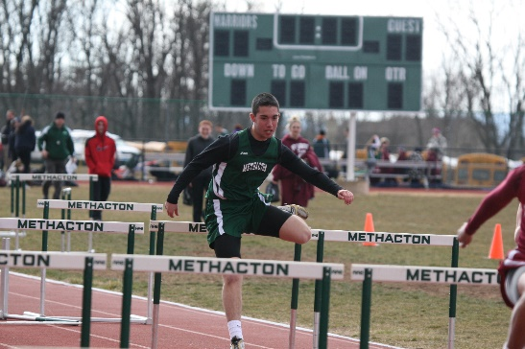
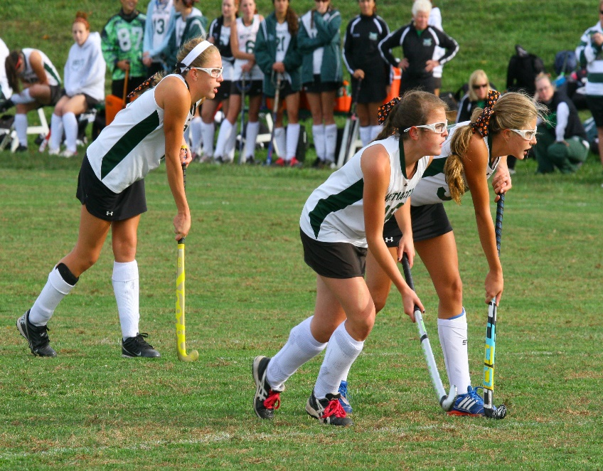
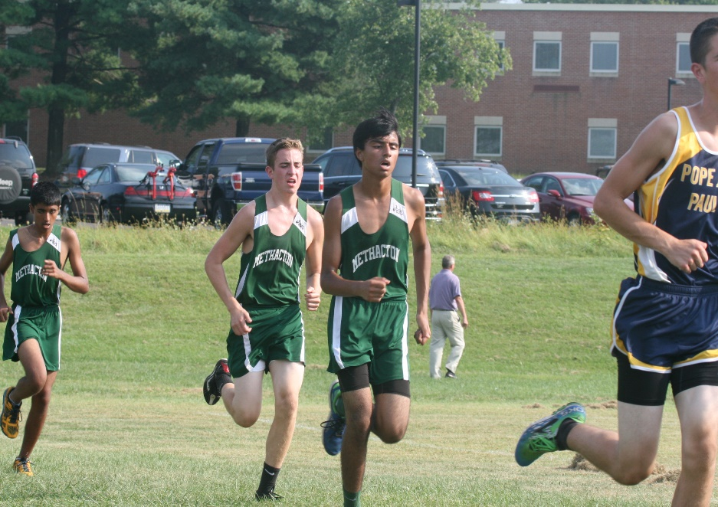
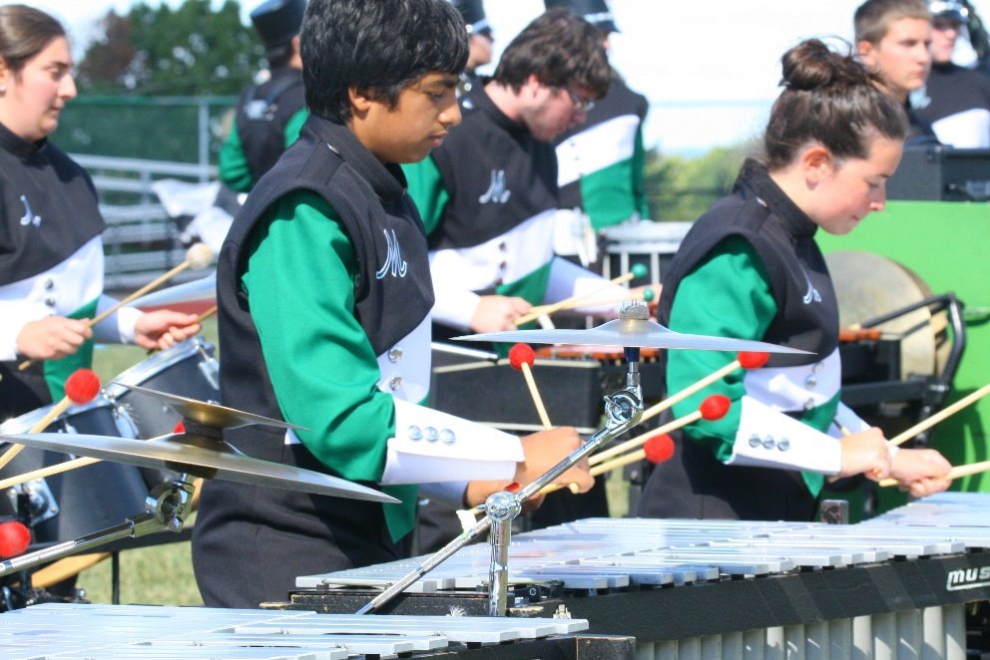
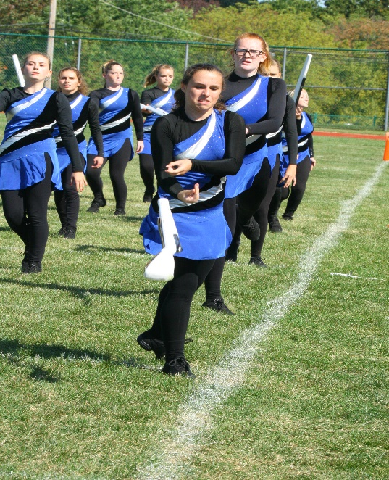
Methacton High School Campus
Fields Improvement Project

Slide 3
Agenda
History
Project Components/Reasons
Funding
Recommendations
Next Steps

Slide 4
Historical Timeline
October 21, 2008 – Athletic feasibility study presented to board
October 18, 2011 – Athletic Director and coaches present Methacton High School Athletic Fields Improvement Project to Board
October 25, 2011 – Board approves field and light improvement project

Slide 5
Historical Timeline
November 22, 2011 – Board approves Architerra as architect
May – June 2013 – Drawing K undergoes modifications in order to meet regulatory, playability, and safety requirements and is submitted as the approved plan for land development
December 18, 2013 – Worcester Twp. Planning Commission recommends preliminary final approval of land development plan

Slide 6
Historical Timeline
January 7, 2014 – Architerra and administration present field project & get approval of bid solicitation
February 26, 2014 – Board approves re-bid of field project
March 4, 2014 – Board approves $5.5 million bond

Slide 7
Historical Timeline
May 22, 2014 – Bids from 2nd bid rejected
June 2014 – Advisory committee formed
September 23, 2014 – Board approves solicitation of bids (3rd time)

Slide 8
Historical Timeline
December 3, 2014 – Opening of bids
December 16, 2014 –Property Committee of Board reviews bids with Superintendent and approves moving forward for full board approval
December 17, 2014 – Worcester Twp. Supervisors Approve Conditional Use Application, but with multiple conditions

Slide 9
Historical Timeline
December 18, 2014 – Board approves Solicitor to file appeal of Worcester Twp. Conditional Use decision
December 30, 2014 – Resident withdraws appeal of DCED decision on Bond
January 12, 2015 – Superintendent recommends Board approval to begin construction on or about March 2, 2015

Slide 10
Reasons for Project
Safety of our athletes and students
Playability (currently 11 fields short)
Safety of neighbors and surrounding area
Place the quality of our athletic complex on par with the academic quality of our district
Bring community together (Friday night football, band, other evening events)
Maintain quality of life, schools, and community

Slide 11
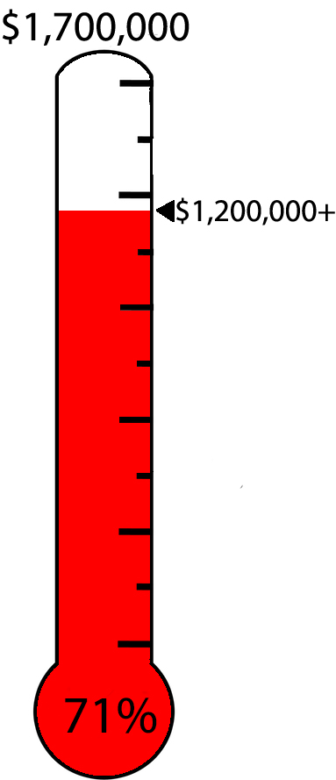
Funding
Public / Private effort
Public Funds - Bond
Private Funds - Capital Campaign with goal of $1.7 Million
Raised in excess of $1.2 million to date
Handling in-kind, cash, and stock contributions
Multi-phase fund raising campaign
One-time and multi-year gifts available
Naming rights
Opportunities for all to participate

Slide 12
Major Improvements (based on approved Plan K)
Campus-wide storm water management
Stadium field
Track
Auxiliary field
Softball fields

Slide 13
Stadium Field
Stadium field to be converted to synthetic turf
Construct 1 restroom building
Plumbing
Install electric service - non-field lighting
Install sound reinforcement system
Install field lighting (5 Poles)
Install new stadium perimeter fencing
Install portable sleeved ball control netting
Score board

Slide 14
Track
Repair, polyurethane, and re-paint track oval
Install track D area and runways
Install sand catcher systems & sand pits /w covers
Install pole vault uprights
Install shot putt and javelin area

Slide 15
Auxiliary Field
Construct auxiliary synthetic turf field
Install electric service - non-field lighting
Install field lighting for auxiliary field (6 poles)
Install ball control netting
Install new perimeter fence
Score board

Slide 16
Softball Fields
Construct two new softball fields (Varsity and JV)
Install outfield fences, backstops, and warning tracks
Install four dugouts (2 on each field)
Install electric service
Construct flagpole near softball field & auxiliary field
Score boards for both fields
Parking lot paving/repair (at completion of project)

Slide 18
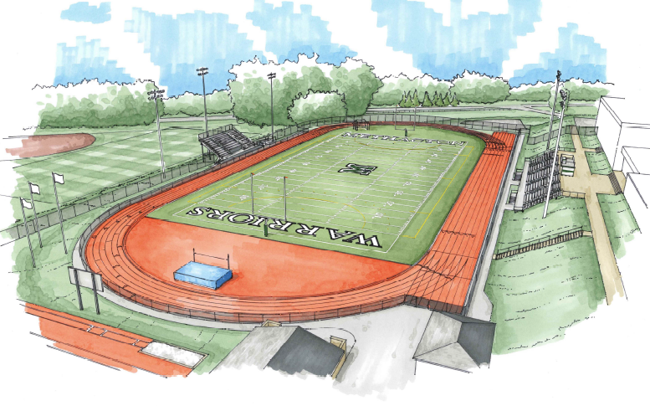

Slide 19
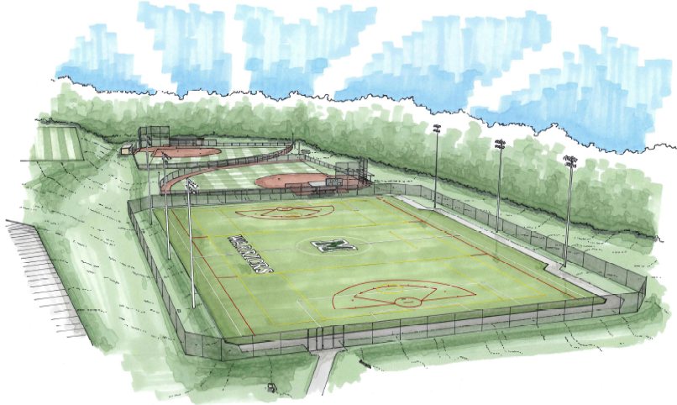

Slide 20
Recommendation
Based on:
December 3, 2014 bids received
December 16, 2014 bids reviewed with Property Committee
Approve bids in total of $4,918,200

Slide 21
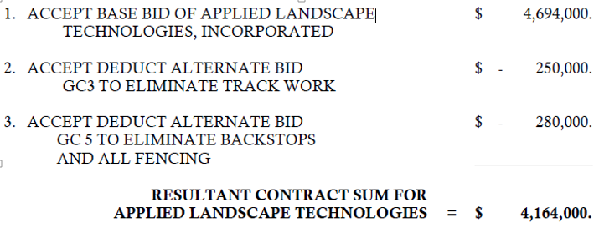
Prime General Construction Bid

Slide 22
Prime General Construction Bid
Approve the general prime construction base bid by Applied Landscape Technologies Inc. and accept the deduct alternate bid GC3 to eliminate track work, and accept the deduct alternate bid GC5 to eliminate backstops and all fencing in an aggregate amount of $4,164,000.
Approve the independent construction bid by American Athletic Courts for all track work for a total of $249,000.
NOTE: Change Order Deduct for turf in-fill
Base bid includes crumb rubber. Acceptable alternative in-fill will be acquired via in-kind, donation, rebid, or under state contract.

Slide 23
Prime Electrical Bid

Slide 24
Prime Electrical Bid
Approve the electrical prime construction base bid by Ronald Janney Inc. and accept the deduct alternate bid EC2 from Ronald Janney Inc. to eliminate all field lighting related work in the aggregate amount of $437,800.
NOTE: Deduct for field lighting work
At this time, we do not have the ability to pull permits to erect poles and install lighting that is safe for our intended use. At the conclusion of litigation (appeal of Worcester Twp. Conditional Use decision) on this matter, we will make that award.
We have the ability to move forward with the land development that will include the running of conduit in the form of change order or in-kind contribution, donation, re-bid. This decision will be done post award.

Slide 25
Prime Plumbing Bid

Slide 26
Prime Plumbing Bid
Approve the plumbing prime construction base bid of Vision Mechanical Inc. in the amount of $67,400.

Slide 27
Donation
Accept the donation in the amount of $205,810 for backstops and fencing from J.P. Mascaro and Sons.

Slide 28
Timeline
January 12, 2015 Bid award
January 2015 File appeal with Commonwealth Court on Worcester Conditional Use decision
January 13-31, 2015 Organize construction schedule/ground breaking ceremony
March 2, 2015 Construction begins on or about
August 7, 2015 Substantial completion
September 19, 2015 Punch list fulfillment by contractor

